Slide 1
Github Actions in Action
Beyond CI

Slide 2

About Me
Senior Development Manager at Agoda
NUnit Contributor
Coming to Thailand for 10 years for business
Originally from Australia
I live in Bangkok
I like Beer and Sport

Slide 3
Agenda
What is Github Actions
How can I use it?
Classic CI example
Work Automation examples
Creating your own Actions

Slide 4
What is it?
It’s very cool

Slide 5
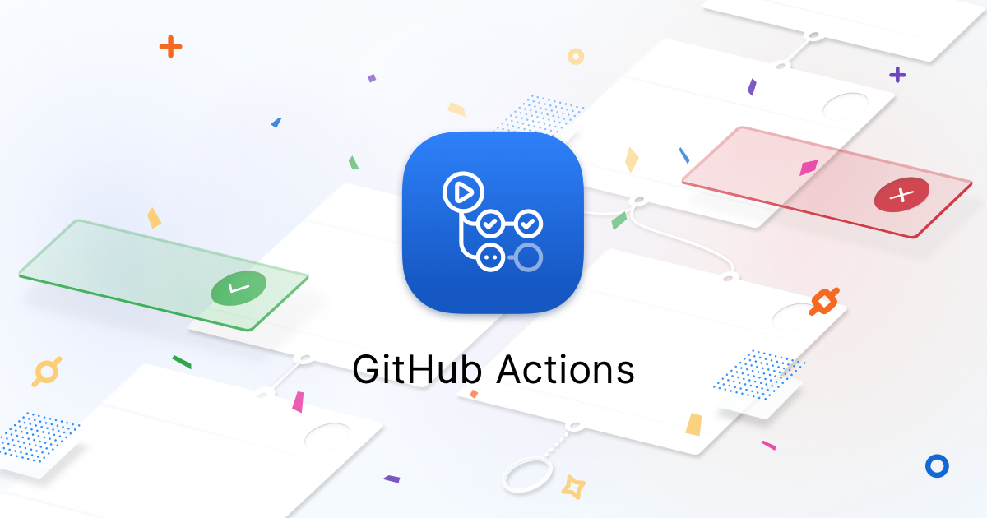
What is it?
Event Driven Workflow automation system
Can be used for CI

Slide 6
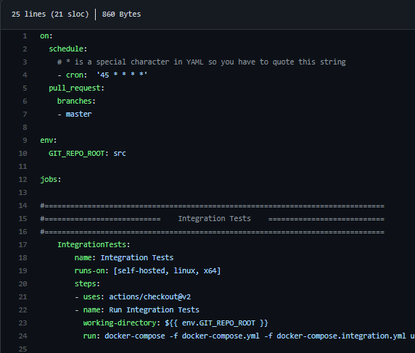
What is it?
Yaml based
Build-As-Code

Slide 7
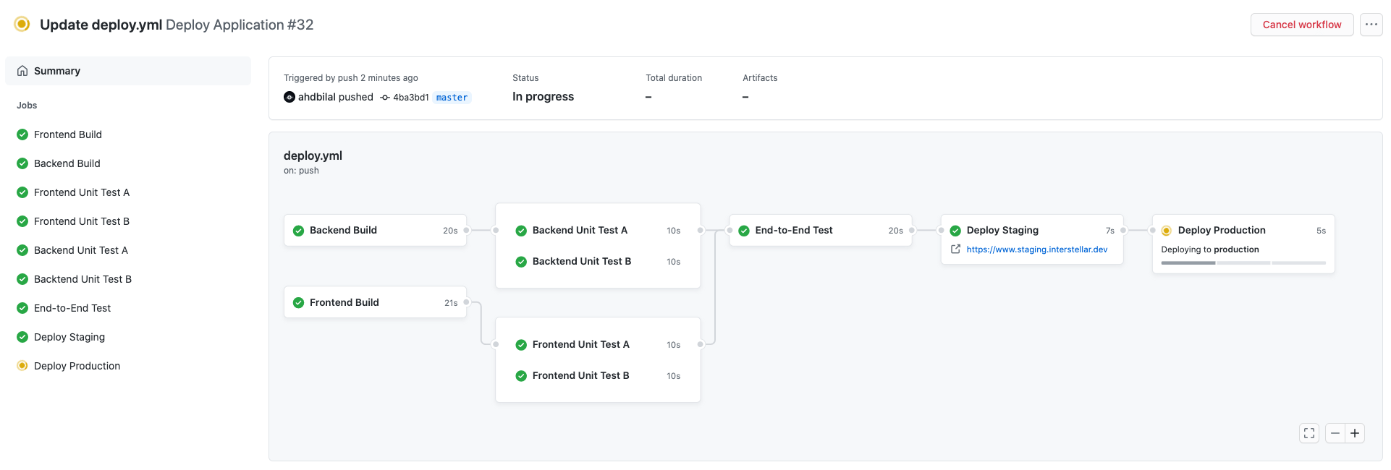
What is it?
Visual UI reporting in Github, with your code

Slide 8
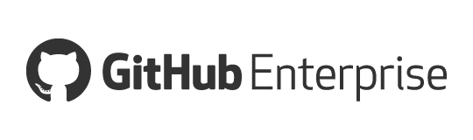
What is it?
Packaged with github dot com
And Github Enterprise Server for on-prem

Slide 9
How can I use it?
You can use it now!

Slide 10
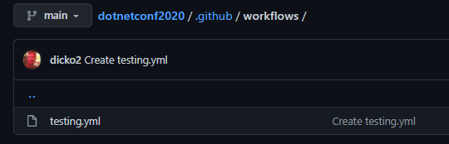
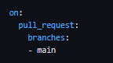
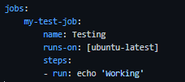
How can I use it?
Github dot com
Create yaml file in /.github/workflows
Specify yaml for event trigger (i.e. “ON”)
Specify yaml actions (i.e. “JOBS and STEPS”)

Slide 11
How can I use it?
Runners? Github provide cloud base runners
You can create your own runners on-prem to use with Github dot com or GHE
Runners can be create at
Enterprise wide (multiple orgs in github.com or server wide on GHE)
Org wide, restricted to a single Org
Repo only, register and used on a single repo
Example cloud-init scripts (AWS, ARM, Openstack, etc)
With example of using a corporate proxy server https://github.com/dicko2/dotnetconf2020/

Slide 12
How can I use it?
Cloud Runners you pay per minute
Linux 1min =1min
Windows 1min = 2min
Mac 1min = 10min
On prem runner time is free on dot com and GHE

Slide 13
Classic CI Example
From Agoda’s Opensource Projects

Slide 14
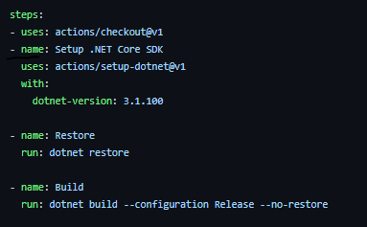
Run vs Action
Simple command line “run”

Slide 15
Run vs Action
Custom action
The “uses” is an address
actions/setup-dotnet@v1
==
This Repo https://github.com/actions/setup-dotnet
With Git Tag v1

Slide 16
Classic CI Example
Library
https://github.com/agoda-com/Agoda.IoC/
Edit build changes on branch
Builds changes don’t run on forks though (By default)

Slide 17
Work Automation Examples
From Agodaians

Slide 18
Using it for NOT CI?
Let’s look at the problems first

Slide 19
Work Automation Examples – On call
Situation
We do a lot of communication via slack, we also support other tech teams via code reviews, issues with our systems etc.
Problem
We have a daily on call rotation, and sometimes its hard to know who is on-call and/or what the current issues are. As a user I want to know who to reach out to and also some basic info that maybe I can read and not have to reach out to them

Slide 20
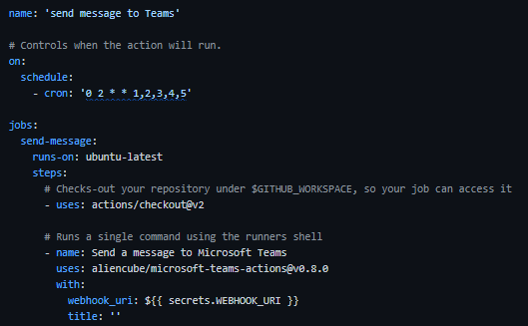
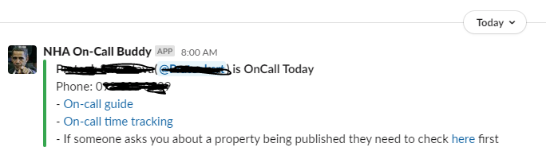
Work Automation Examples – On call
Action!
Build an Action that
reads from on-call rooster
Read markdown from basic wiki
Post to support channel with current on-call person info and also basic trouble shooting info daily

Slide 21
Work Automation Examples – Expensive Tests
Situation
We have created Benchmark test that are expensive to run and only require if the reviewer thinks that your changes will impact performance
Problem
We only want to run them when the review deems it needed, and we want to review the results with the PR and recorded somewhere

Slide 22
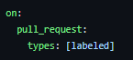
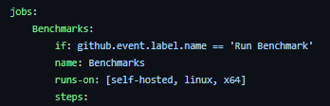
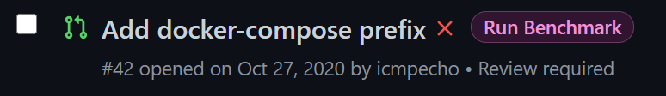
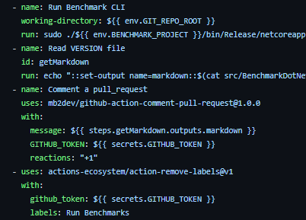
Work Automation Examples – Expensive Tests
2
On PR “labeled” event
Action!
1
Create a label
3
If label is “Run Benchmark”
Collect markdown report and post on PR with a “+1”
4

Slide 23
The Big Pull Request
How big?

Slide 24
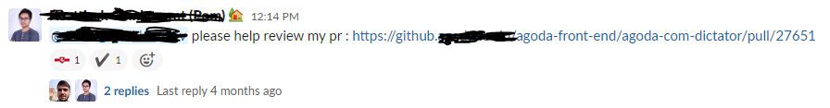

Please help Review my PR?

Slide 25
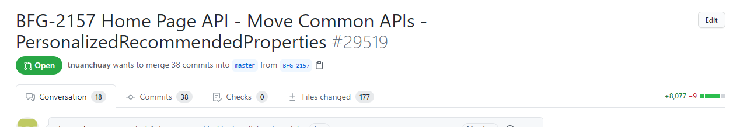

Please help Review my PR?

Slide 26
The Challenge ?
People don’t always create the PR early
Automation on PR wont work
Need to automate on Branch Push and check size of diff

Slide 27
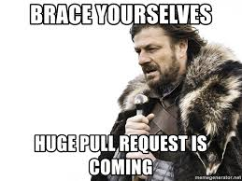
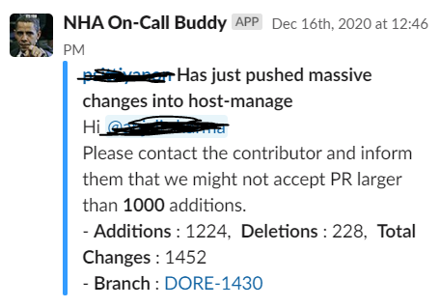
Big Pull Request Alert in Slack
We are also able to reuse our logic for checking on-call person and tag them

Slide 28
You aren’t limited to only this
A massive array of options is available!

Slide 29
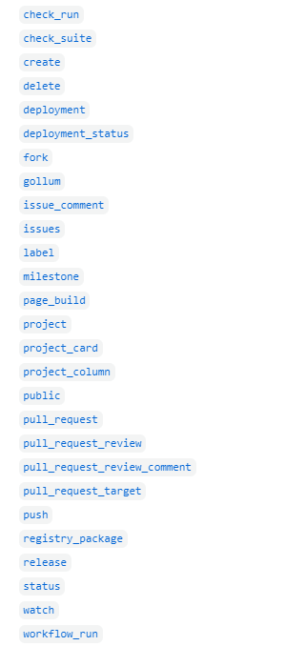

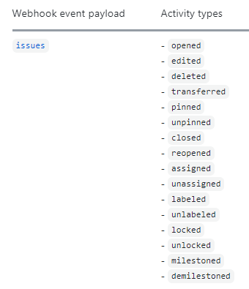
Events you can trigger on
?
https://docs.github.com/en/actions/reference/events-that-trigger-workflows
Hundreds of events to rigger from

Slide 30
Making your own Action
In any Language you want!

Slide 31
Making your own Action
Two types
Docker Actions – Flexible with language
Nodejs Action – powerful with library support

Slide 32

Making your own Action – Docker - Flexible with Language
Haskal, Erlang, Golang… even Fish
https://github.com/kai-tub/external-repo-sync-action/blob/master/entrypoint.fish

Slide 33
Making your own Action - Docker
https://github.com/agoda-com/ga-nuget-alpha-detection
Example is PowerShell (actions.yml, Dockerfile, entrypoint.ps1, and don’t forget a readme.md)
The Action in Action
https://github.com/agoda-com/ga-samples/blob/master/.github/workflows/nuget-alpha.yml
https://github.com/agoda-com/ga-samples/blob/master/nuget-alpha/ConsoleApp1.csproj
https://github.com/agoda-com/ga-samples/runs/1724962818?check_suite_focus=true

Slide 34
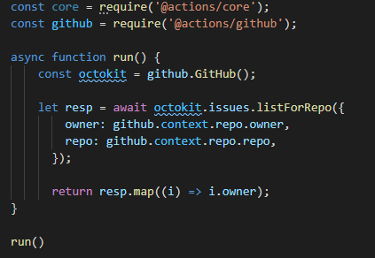
Making your own – Powerful library support
https://github.com/actions/toolkit
https://octokit.github.io/rest.js/v18/

Slide 35
Think about Repetitive Tasks
What do you do that you could automate?
You can turn that into an Action

Slide 36
Where are we going with this?
The sky is not the limit

Slide 37
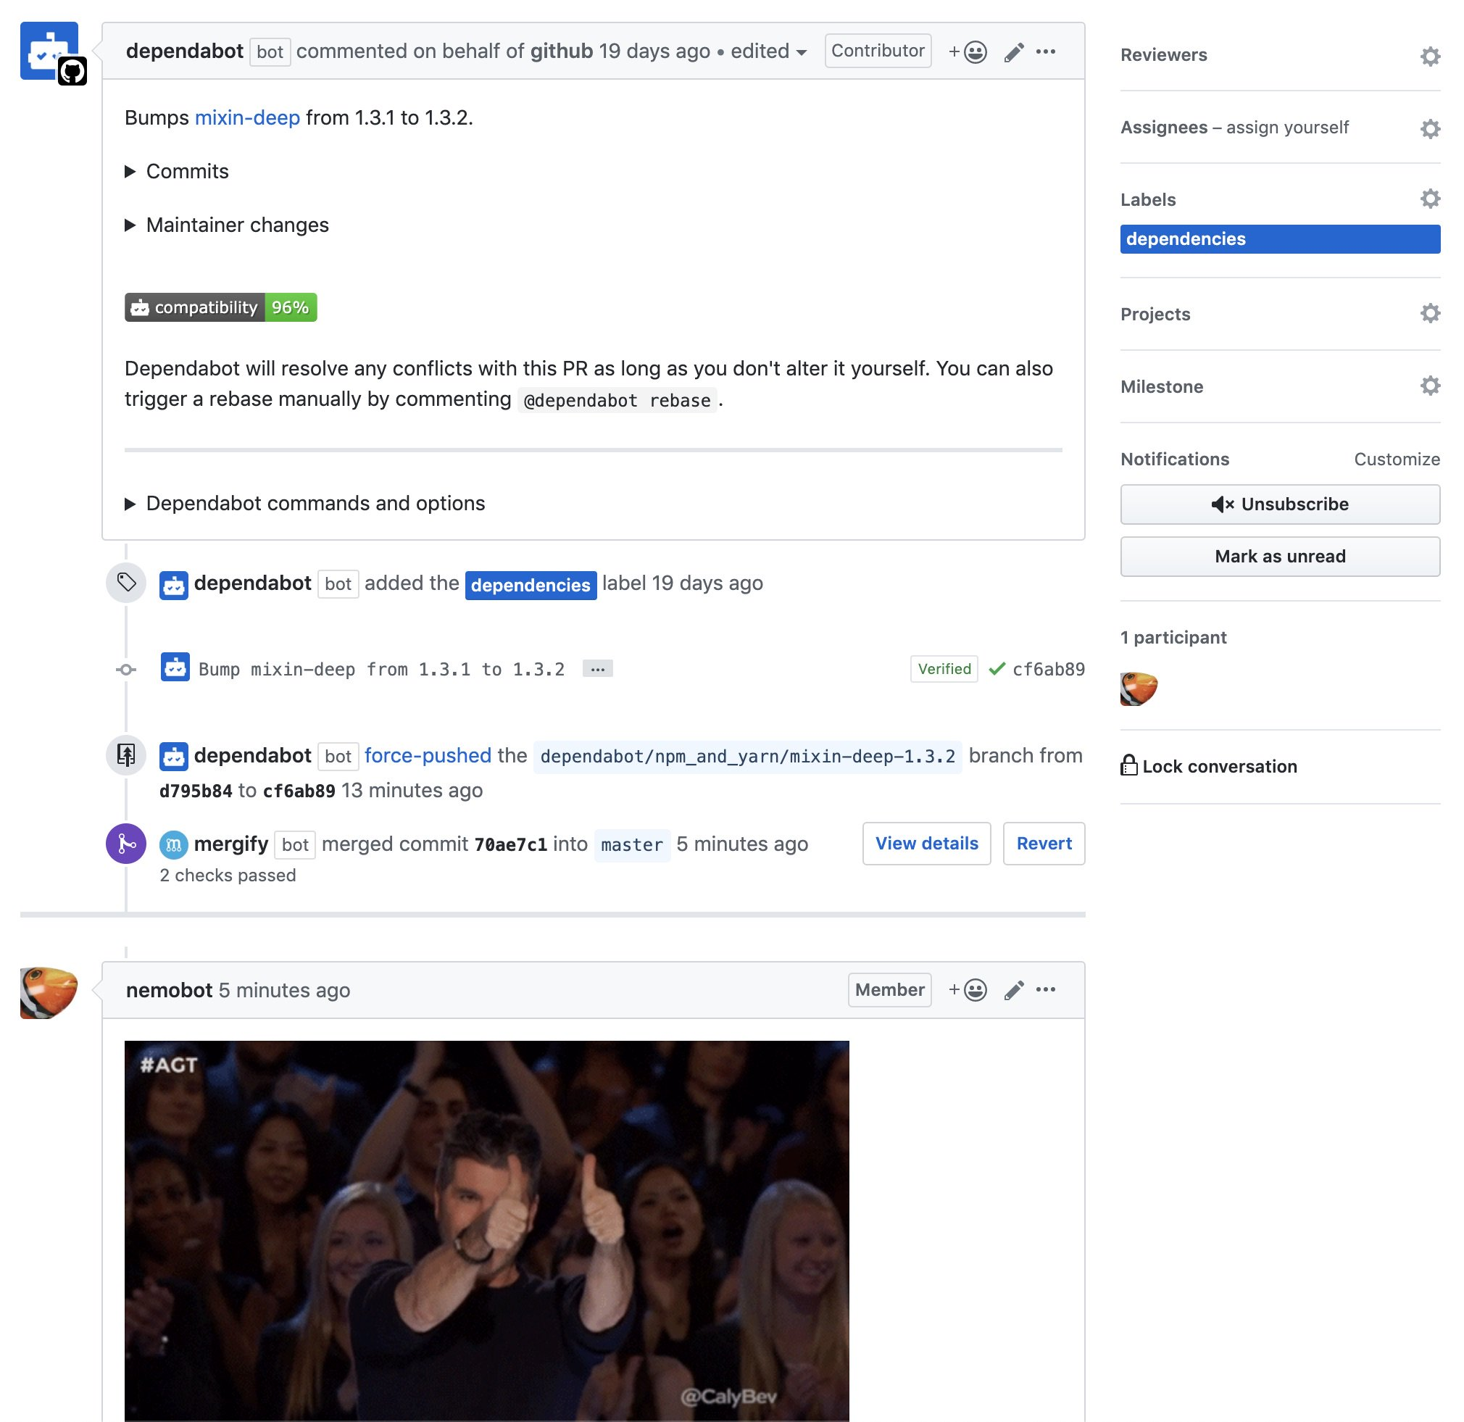
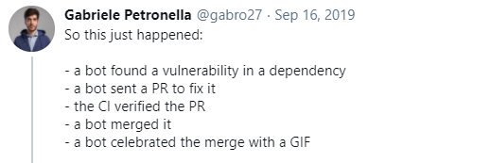
No limits, keep it going!
Happy automating!

Slide 39



THANKS!
Any questions?
You can find me at:
https://beerandserversdontmix.com/
www.linkedin.com/in/joel-dickson-hs
https://github.com/dicko2/

